Slide 1
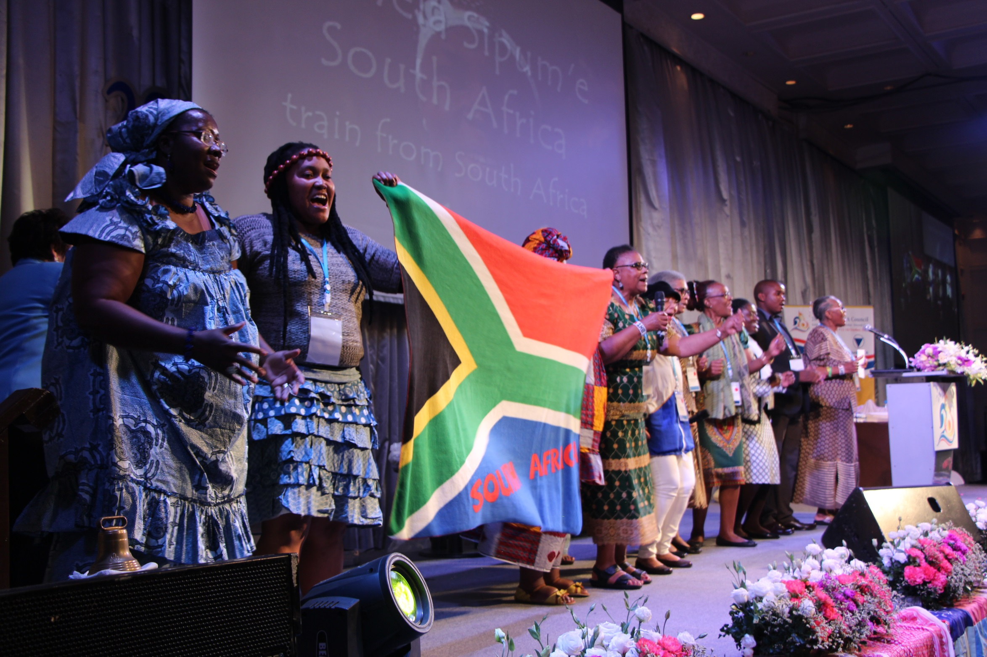
Young women changing narratives around SRHR and Mental Health
Empowering young women’s advocacy for SRHR and Mental Health

Slide 2
JILL
Regional Coordinator- Africa

Slide 3
NIRMALA
Regional Coordinator- Asia

Slide 4
VERA
Regional Coordinator- Europe

Slide 6
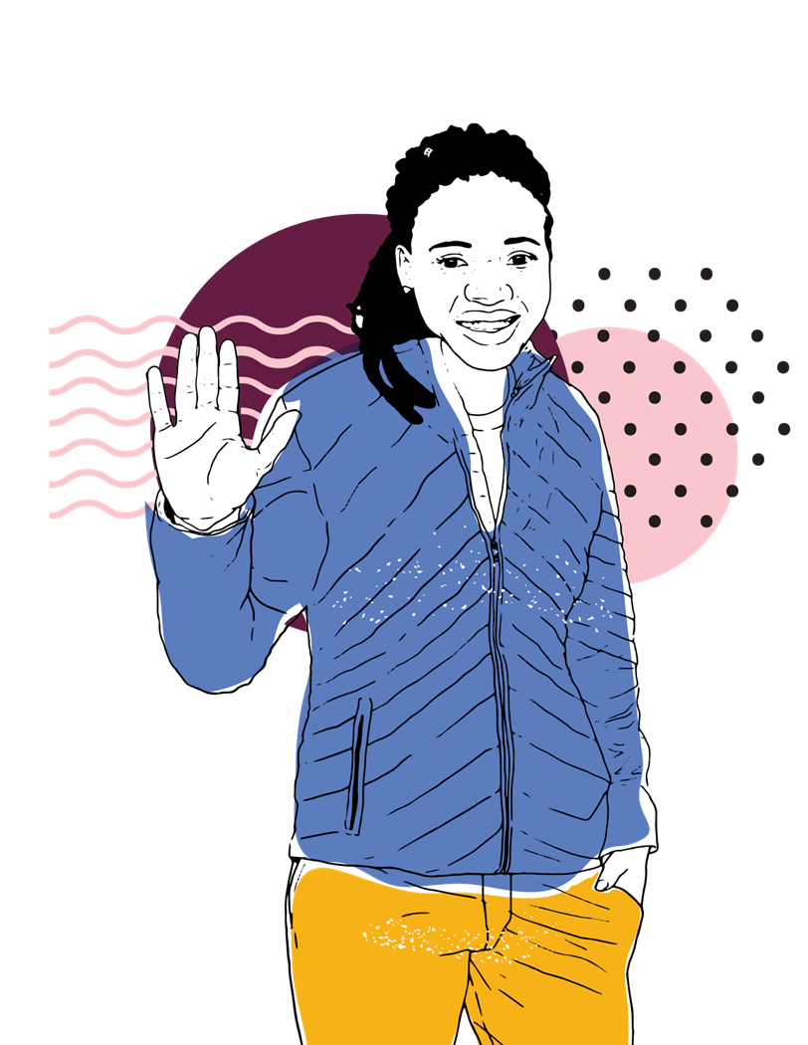
Hello
Everyone,
Let’s begin with an energizer!

Slide 7
According to UNFPA (2018), 860 million young women and girls in the world represent the unmet social and health needs by being denied their full sexual and reproductive health and rights and access to essential service that promote and protect their mental health due to a combination of harmful social norms, lack of political and policy commitment to extend services, and negative narratives that discriminate against young women.

Slide 8
The collective action to transform key negative narratives to impact positively on policy decisions that enhance young women’s sexual and reproductive health and rights (SRHR) and mental health

Slide 9
To create a more inclusive and less discriminatory society where young
women and girls have their human rights fulfilled
Supporting 400 young women champions
Improving young women’s knowledge and understanding of their sexual and reproductive rights and mental health
Build the capacity of young women to advocate and drive collective action to influence policy and service barriers at global, regional and national level

Slide 10
FOCUS REGIONS
E. EUROPE
ASIA
AFRICA

Slide 11
SRHR & MENTAL HEALTH
SRHR?
Sexual and Reproductive Rights (SRR) are part of the vast field of Human Rights as contained in various national and international rights documents.
According to the International Planned Parenthood Federation’s (IPPF) charter on SSR , there are 12 essential SRR that must be respected, protected, and fulfilled by the states:
● The right to life
● The right to liberty and security of the person
● The right to equality and to be free from all forms of discrimination
● The right to privacy
● The right to freedom of thought
● The right to information and education
● The right to choose whether or not to marry and to found and plan a family
● The right to decide whether or when to have children
● The right to health care and health protection
● The right to the benefits of scientific progress
● The right to freedom of assembly and political participation
● The right to be free from torture and ill treatment
Sexual and Reproductive Rights… are Human Rights!

Slide 12
MENTAL HEALTH?
According to the World Health Organization, Mental Health is a state of well-being in which every individual realizes their own potential, can cope with the normal stresses of life, can work productively and fruitfully, and is able to make a contribution to her or his community.
WHO ARE MOST LIKELY TO BE AFFECTED?.... BUT NOT NECESSARILY
households living in poverty
people with chronic health conditions
infants and children exposed to maltreatment and neglect
adolescents first exposed to substance use
indigenous populations
LGBTIQ+ persons
people exposed to conflict, natural disasters or other humanitarian emergencies

Slide 13
1
Mental health and HIV, STIs
2
Mental health and SRH harmful traditional practices
3
Mental health and persons living with disability and their sexual health
HOW IS SRHR & MENTAL HEALTH INTERLINKED?
Mental health and hormonal contraception
Mental health and SGBV
Mental health and Sexual and Reproductive health
Mental health and LGBTIQ population

Slide 14
It’s Good to note that:
Higher rates of depression, anxiety, obsessive compulsive and phobic disorders, suicidal thoughts and acts, self-harm, and alcohol and drug dependence among LGBTQ+ people.
Women with unintended pregnancies were four times more likely to have experienced intimate partner violence than women whose pregnancies were intended.
Suicide is the leading cause of death among 15 to 19 year-old girls, surpassing maternal mortality.
Post-natal depression is estimated to affect 10-15% of women in the Western Hemisphere
SECOND STEP

Slide 15
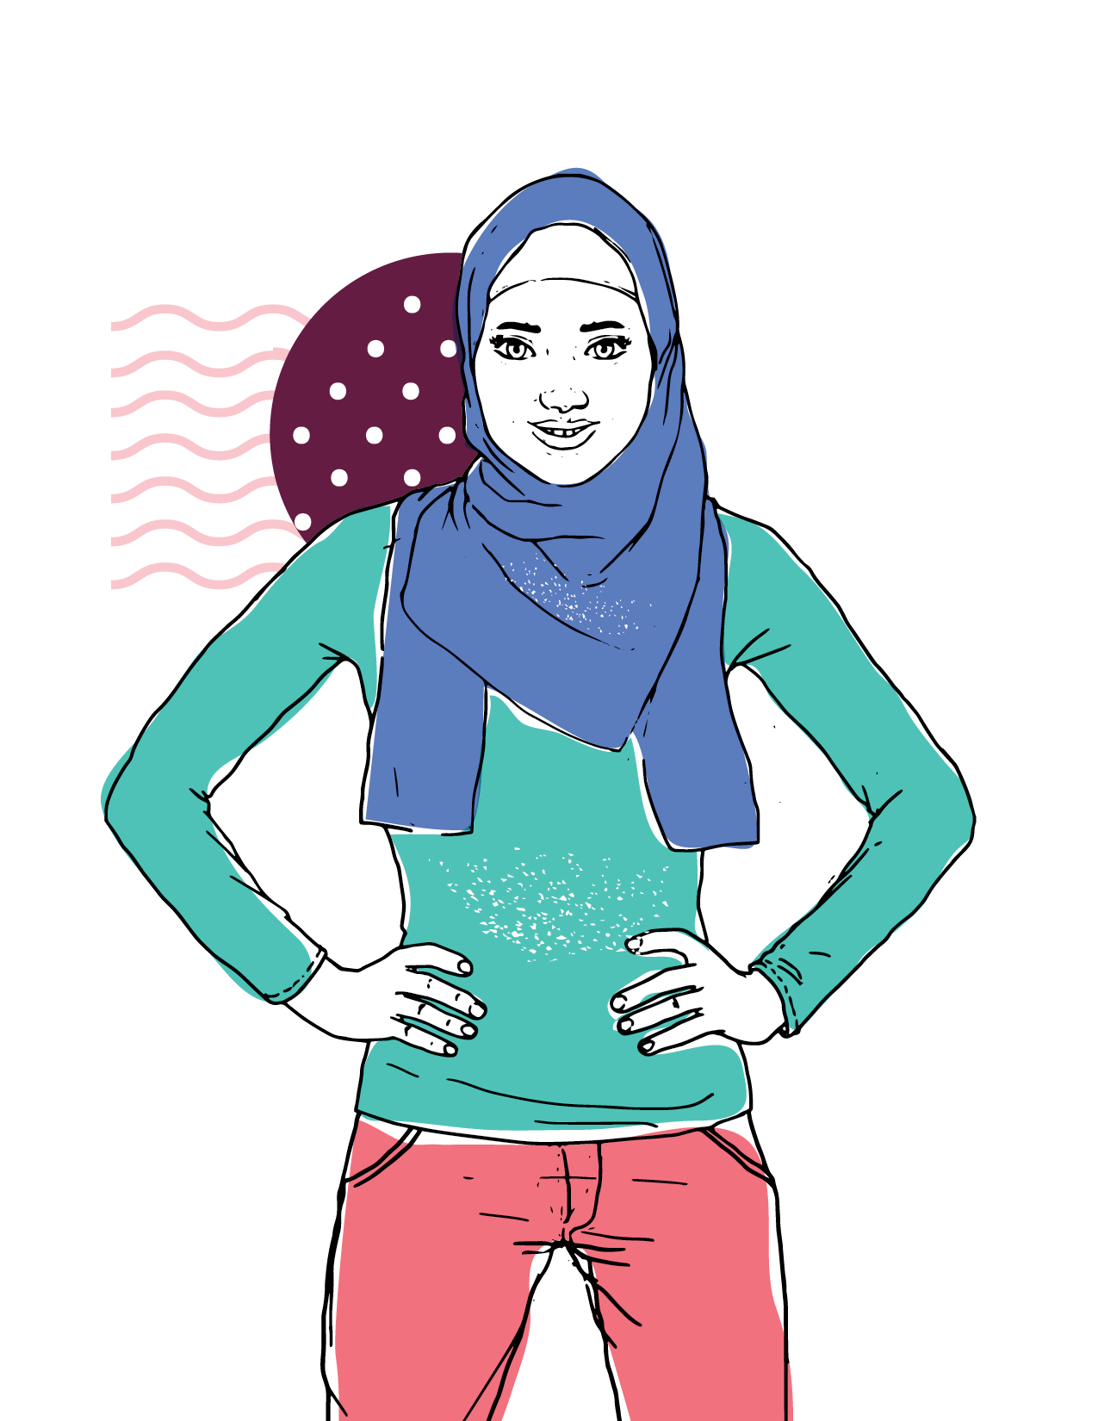
SRHR & MENTAL HEALTH DISCUSSIONS
CASE STUDIES
UGANDA
TAIWAN
KENYA

Slide 16
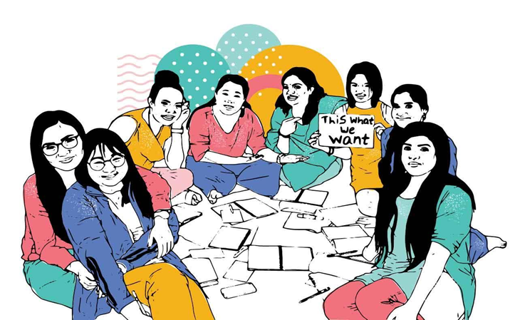
Group Discussions
10 minutes discussion
2 minutes presentation

Slide 17
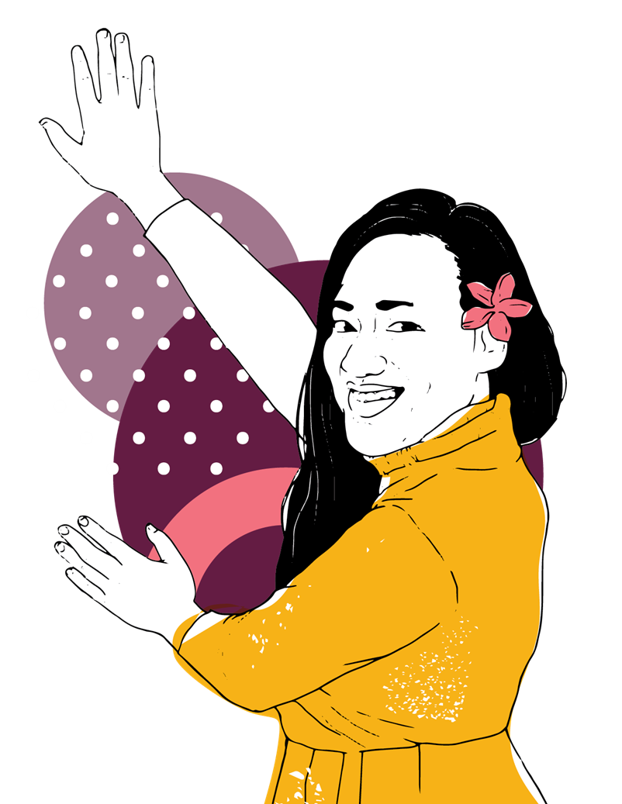
NORMALIZING DISCUSSIONS AROUND SRHR AND MENTAL HEALTH
Activity: Myth-busters
What are the current narratives?

Slide 18
How to Normalize these discussions?
Take a holistic approach
Invest in long-term programming
Focus on positive messages
Develop interventions in partnership with the end-user communities
Story Telling

Slide 19
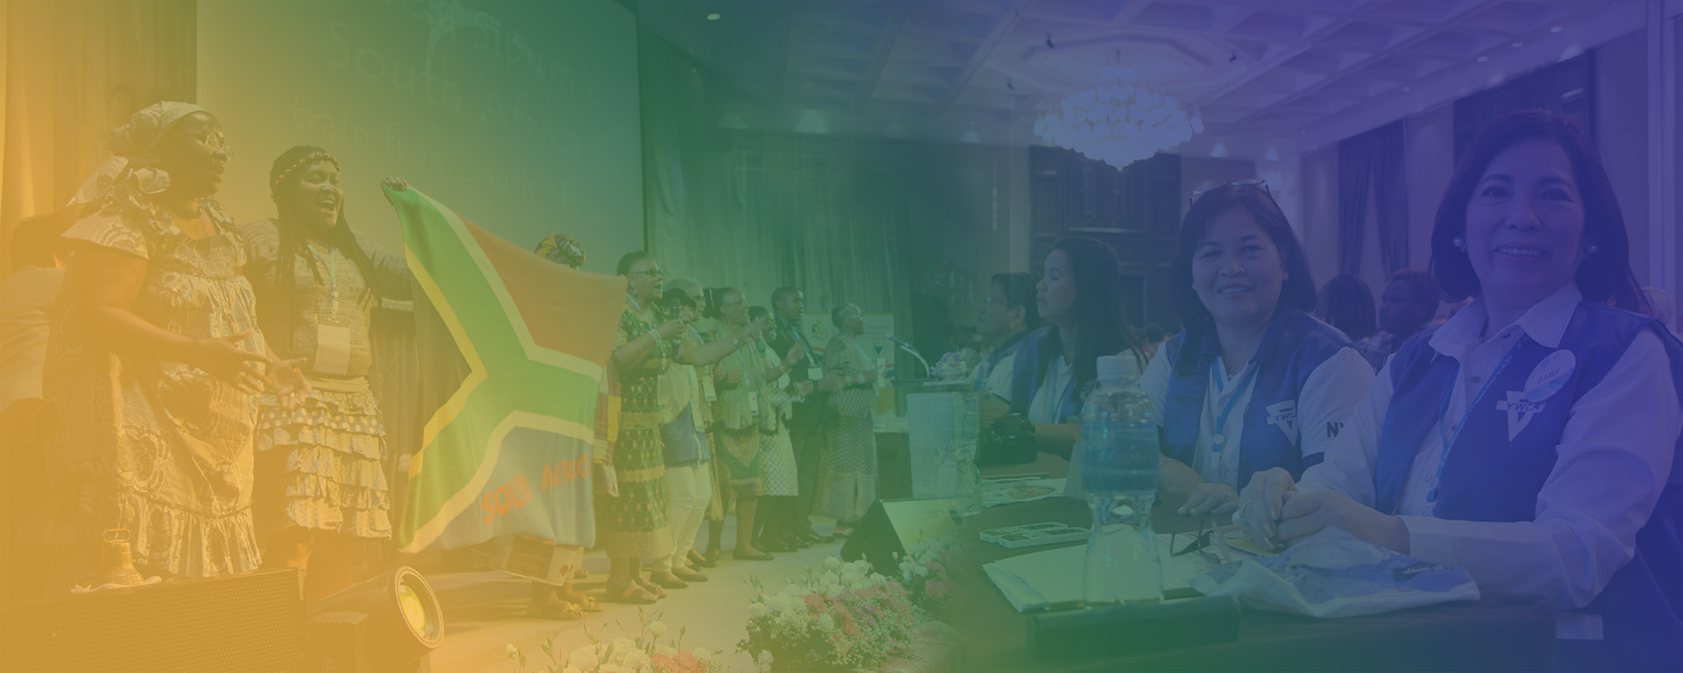
How can we achieve all these?
Regional Trainings
Local, National, Regional and Global forums
Social Media Advocacy
Inter- generational dialogues
Safe Spaces

Slide 20
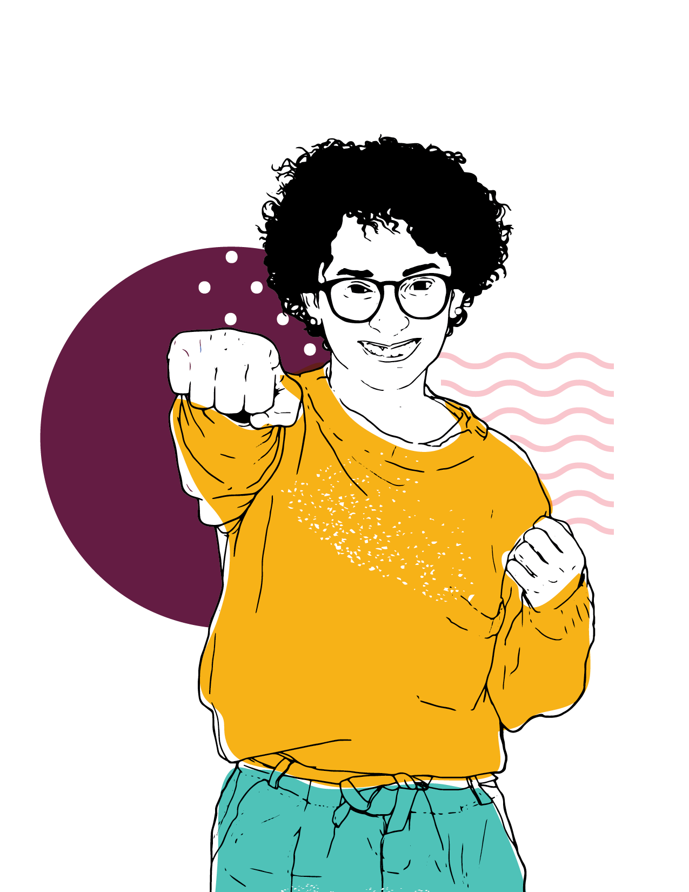
ADVOCACY
Advocacy is being able to influence the formulation and implementation of policies and programs by persuading and pressuring state authorities, international financial institutions, and other powerful actors.
WHY ENGAGE IN ADVOCACY?
To strengthen and empower young women girls on SRHR and mental health
WHEN TO ADVOCATE?
Strike while it’s still hot!!!!

Slide 21
Social Media Advocacy

Slide 22
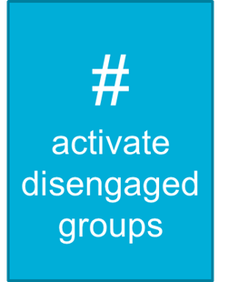
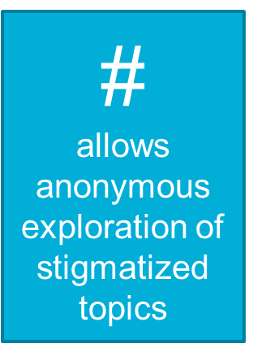

Slide 23
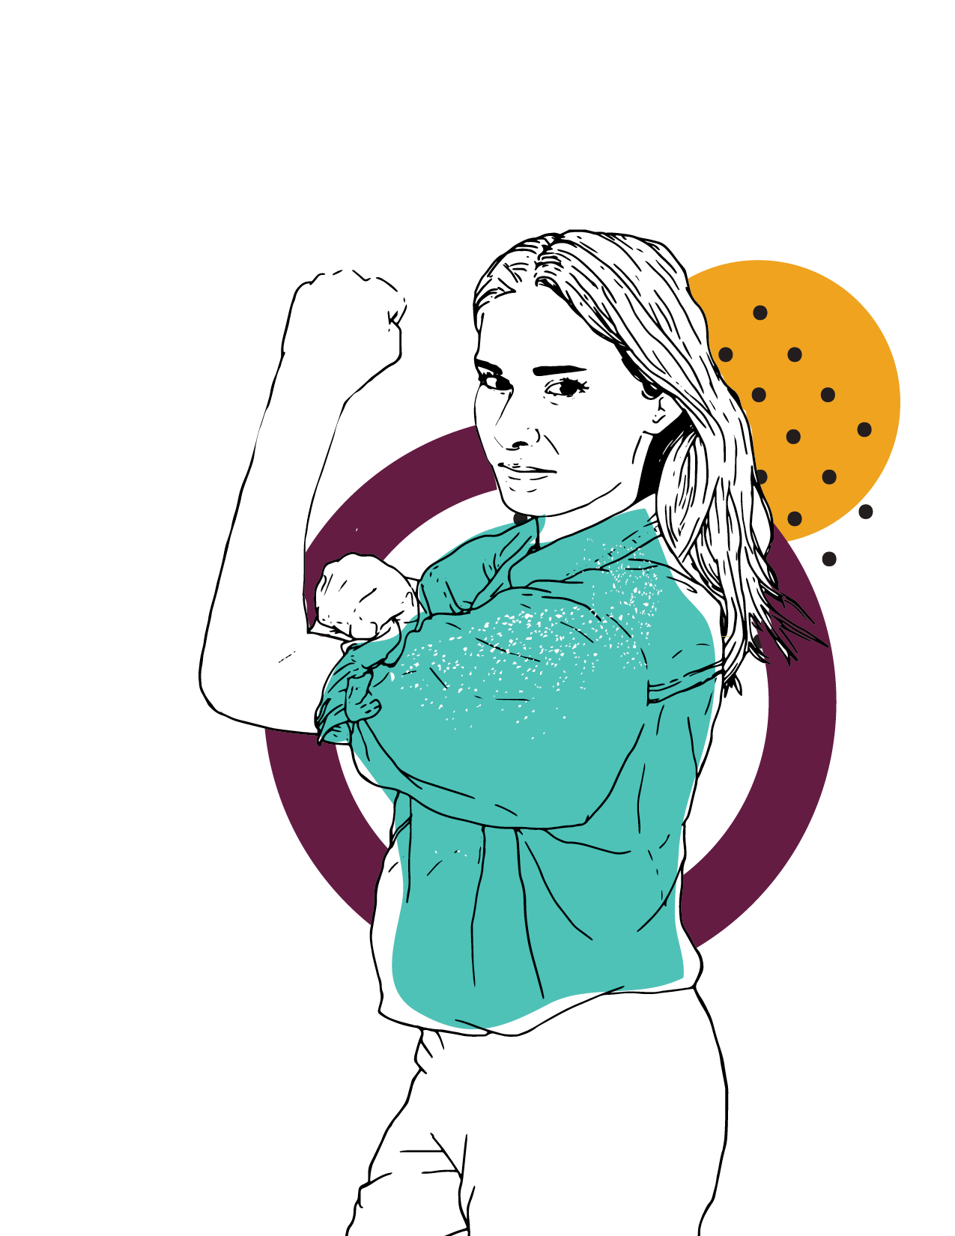
SRHR & MENTAL HEALTH AND ENVISIONING 2035
,
By 2035, 100 million young women and
girls transform power structures to
create justice, gender equality and a
world without violence and war; leading
a sustainable YWCA movement,
inclusive of all women.

Slide 24
Thank YOU!
@worldywca #YoungWomenRise
#WorldCouncil2019 #YoungWomenRise #YoungWomenLead #Intergenerational
#SRHR #MentalHealth

